Slide 1
Building on success:
Update on Cape Light Compact’s
2019-2021
Three-Year Energy Efficiency Plan

Slide 2
Agenda for Presentation
Overview of Cape Light Compact (CLC)
Three Year Energy Efficiency Plan – Cape Light Compact Enhancements and New Opportunities
2019-2021 is the fourth 3-year Energy Efficiency Plan filed by the Program Administrators (PAs).
PAs = Cape Light Compact and & Investor Owned Utilities (e.g. Eversource)

Slide 3
Cape Light Compact
Award-winning energy services organization operated by the 21 towns on Cape Cod and Martha's Vineyard
Mission: serve customers through delivery of
proven energy efficiency programs
effective consumer advocacy
competitive power supply
and green aggregation
Model for other community choice aggregation programs in MA and nationally

Slide 4
Background on Three-Year Energy Efficiency Plan
2008 Massachusetts Green Communities Act (GCA) mandates “electric and natural gas resource needs shall first be met through all available energy efficiency and demand reduction resources that are cost effective or less expensive than supply.”
2018 Amendments to the GCA:
Explicitly allows for cost effective energy storage and other active demand management technologies
Adds cost-effective strategic electrification
Explicitly authorizes renewable funding through EE funds
Changes cost-effectiveness requirement from program level to sector level (increases flexibility)
Meetings with Department of Energy Resources and the Attorney General indicate Program Administrators’ 2019-2021 Energy Efficiency Plans should comply with amendments
Compact works collaboratively with seven other statewide PAs to provide cost-effective energy efficiency programs. These programs are most commonly known as Mass Save®.

Slide 5
Calendar of Events
Date | Action
November 2017 – February 2018 | Stakeholder Engagement Meetings to help inform the 2019-2021 EE Plan
April 30, 2018 | Compact & all PAs submitted draft 2019-2021 Statewide EE Plans
September 14, and October 10, 2018 | Second draft of Plan submitted Third draft of Plan due
October 31 | Compact & all PAs file final 2019-2021 Statewide EE Plan with Department of Public Utilities
We Want Your Feedback:
Cape Light Compact’s online survey – www.capelightcompact.org/eeplan
Email – info@capelightcompact.org

Slide 6
Overview of Compact Programs
Residential is non-income eligible, 61% + of state median income and includes multi-family (5+ units)
Income Eligible is up to 60% state median income, fuel assistance, and other income eligible benefits
Commercial and Industrial is businesses (including non-profits, churches, etc.), industrial, and municipal

Slide 7
CLC Specific Program Enhancements

Slide 8
Enhanced Residential Coordinated Delivery Offerings
Statewide Offerings | Continue Current CLC Enhancements
90% with no cap on insulation measures for: Landlords that agree to complete whole-building scoped weatherization work | 100% with no cap on insulation measures for: Year-round tenants (who pay their own electric bill)
Gas PAs serve gas heated homes, and electric PAs serve all other fuels | Serve customers with natural gas heated homes who prefer to be served by the Compact

Slide 9
Enhanced Residential Income Verification Offerings
Continue Compact-specific income verification for low-income customers
Continue Compact-specific income verification for customers 61-80% of SMI
Household Members | 60% State Median Income (SMI)
1 | $35,510
2 | $46,437
3 | $57,363
4 | $68,289
Notes:
Delete first bullet

Slide 10
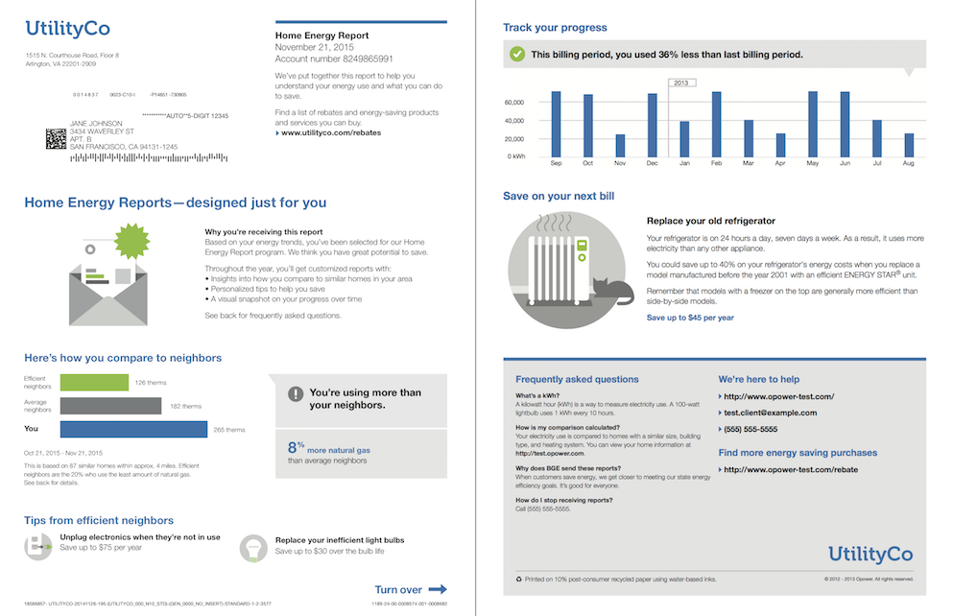
Enhanced Residential Behavior & Demand Management Offerings
Behavior & Demand Management
Considering implementing a home energy report (e.g., OPower)
Notes:
Delete first bullet

Slide 11
Enhanced Residential Offering Strategic Electrification
Objectives
700 total non-gas heated participants, tiered services by income
Additional incentives for low-income (up to 60%), moderate income (61-80%) and extended moderate income (81-120%) customers
Convert oil, propane, electric resistance heat to cold climate heat pumps
Install PV systems to support electrification of heating system, reduce GHG emissions, offset increased electricity usage
Install battery storage for demand response and resiliency

Slide 12
Enhanced Residential Demonstration
Look to explore ways to incentivize connected devices (i.e., smart appliances, WiFi thermostats, plug load controllers, etc.) to reduce residential energy use.

Slide 13
Summary of Enhancements for C&I Programs
Continue enhancements for thermal measures in the New Construction and Major Renovation program as well as the C&I Retrofit program
Municipalities – 7% of total C&I customers
Incentives (up to 100%) for greater cost coverage with equipment maintenance training to ensure savings with board approval for projects over $150,000.
Continue to offer Small Business incentives up to 100% as well as a zero-interest financing option
Continue to offer a Business Energy Audit (BEA) which offers 100% incentive coverage for certain instant savings measures (ex. efficient lighting, water saving measures, etc.)
Non-profits
Up to 100% coverage for recommended improvements
For 501 (c)(3) that promotes economic, social, cultural development on Cape or Vineyard or to organizations providing services to the low income population
Operating ≥3 years with unrestricted annual op. rev. <$15M
Main Streets Initiative

Slide 14
Enhancements for Residential and C&I Programs
Exploring residential battery storage to reduce peak demand in homes that have distributed energy resources
Will then look to investigate the potential for offering this to C&I customers
Explore ways to reduce demand through Electric Vehicle Charging
Shifting charging to off-peak hours

Slide 15
Thank You!
April Draft
https://3jy14ha9u771r7qzn35g0s6c-wpengine.netdna-ssl.com/wp-content/uploads/2018/05/2019-2021-Three-Year-Energy-Efficiency-Plan-April-2018.pdf
Appendices
https://3jy14ha9u771r7qzn35g0s6c-wpengine.netdna-ssl.com/wp-content/uploads/2018/05/Appendices-to-2019-2021-Energy-Efficiency-Plan-April-30-2018-No-App-G-Potential.pdf
Feedback
Cape Light Compact’s online survey www.capelightcompact.org/eeplan
Email
info@capelightcompact.org

